Slide 1


Electric Circuits
Twelfth Edition, Global Edition
Chapter 4 – Part 6
Techniques of Circuit Analysis
© 2024 Pearson Education Ltd. All Rights Reserved.
Notes:
If this PowerPoint presentation contains mathematical equations, you may need to check that your computer has the following installed:
1) Math Type Plugin
2) Math Player (free versions available)
3) NVDA Reader (free versions available)

Slide 2
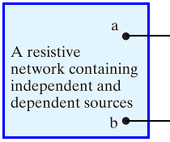
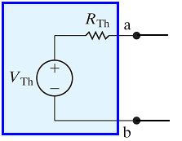

Chapter 4 – techniques of circuit analysis (1 of 12)
Thevenin and Norton equivalents
A circuit simplification technique
Can be applied to any circuit consisting of resistors and sources

Slide 3
Chapter 4 – techniques of circuit analysis (2 of 12)
What instrument could we use to determine the voltage across the open circuit in these two circuits?
A. An ohmmeter
B. A voltmeter
C. An ammeter
D. None of the above

Slide 4


Chapter 4 – techniques of circuit analysis (2 of 12)
What instrument could we use to determine the voltage across the open circuit in these two circuits?
A. An ohmmeter
B. A voltmeter
C. An ammeter
D. None of the above

Slide 5
Chapter 4 – techniques of circuit analysis (3 of 12)
What instrument could we use to determine the current through a short circuit between nodes a and b in these two circuits?
A. An ohmmeter
B. A voltmeter
C. An ammeter
D. None of the above

Slide 6
Chapter 4 – techniques of circuit analysis (3 of 12)
What instrument could we use to determine the current through a short circuit between nodes a and b in these two circuits?
A. An ohmmeter
B. A voltmeter
C. An ammeter
D. None of the above

Slide 7



Chapter 4 – techniques of circuit analysis (4 of 12)
If we create a short circuit at the output, between nodes a and b, what is the current in this short circuit?
A.
B.
C.
D. None of the above

Slide 8
Chapter 4 – techniques of circuit analysis (4 of 12)
If we create a short circuit at the output, between nodes a and b, what is the current in this short circuit?
A.
B.
C.
D. None of the above

Slide 9
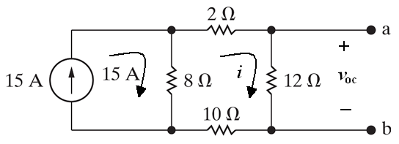


Chapter 4 – techniques of circuit analysis (5 of 12)
Thevenin and Norton equivalents
  Find the Thevenin equivalent of the circuit below to the left of the terminals a,b.
    Find the open-circuit voltage:

Slide 10

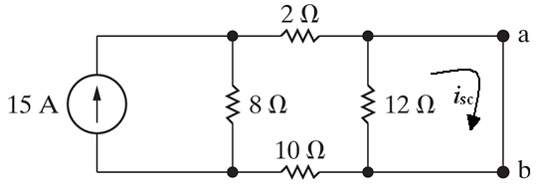
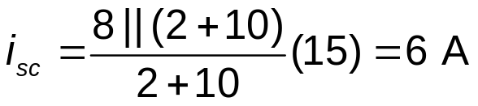
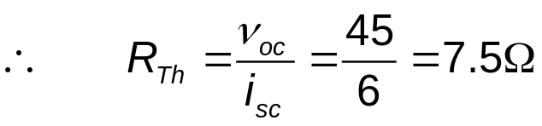
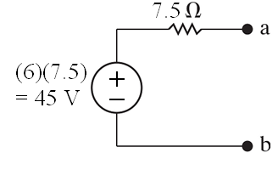
Chapter 4 – techniques of circuit analysis (6 of 12)
Find the short-circuit current. Here we use current division, noting that
the short circuit effectively removes the
resistor from the circuit:
The Thevenin equivalent for this original circuit is shown below:

Slide 11
Chapter 4 – techniques of circuit analysis (7 of 12)
We could use an ohmmeter to measure the Thevenin resistance, so long as there are no dependent sources in the circuit and we remember to
A. Create a short at the output
B. Place a load resistor at the output
C. “Kill” the source by setting its value to zero
D. All of the above

Slide 12
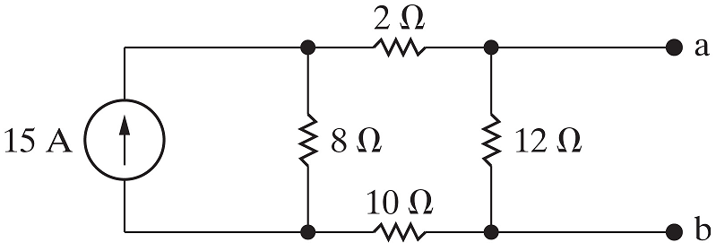
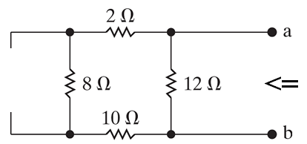


Chapter 4 – techniques of circuit analysis (8 of 12)
Thevenin and Norton equivalents
  Find the Thevenin resistance be killing the source and making series and parallel combinations of resistors.

Slide 13
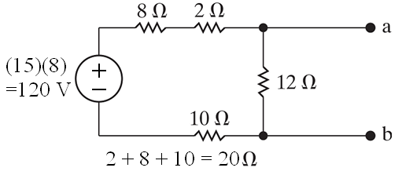
Chapter 4 – techniques of circuit analysis (9 of 12)
Thevenin and Norton equivalents
  An alternative approach – find the Thevenin equivalent of the circuit to the left of the terminals a,b using a series of source transformations.
First step:

Slide 14
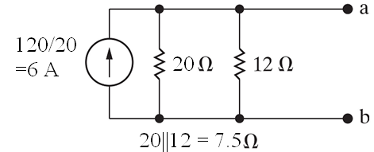
Chapter 4 – techniques of circuit analysis (10 of 12)
Thevenin and Norton equivalents
  An alternative approach – find the Thevenin equivalent of the circuit to the left of the terminals a,b using a series of source transformations (continued).
Second step:
Third step:

Slide 15
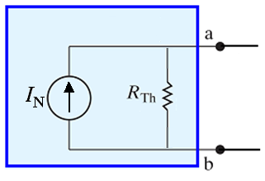



Chapter 4 – techniques of circuit analysis (11 of 12)
The Norton equivalent is just the source-transform of the Thevenin equivalent. Therefore,
A.
B.
C. Neither A nor B
D. Both A and B

Slide 16
Chapter 4 – techniques of circuit analysis (11 of 12)
The Norton equivalent is just the source-transform of the Thevenin equivalent. Therefore,
A.
B.
C. Neither A nor B
D. Both A and B

Slide 17

Chapter 4 – techniques of circuit analysis (12 of 12)
Thevenin and Norton equivalents
  Find the Norton equivalent of the circuit to the left of the terminals a,b.
Just source-transform the Thevenin equivalent!

Slide 18

Copyright
This work is protected by United Kingdom copyright laws and is provided solely for the use of instructors in teaching their courses and assessing student learning. Dissemination or sale of any part of this work (including on the World Wide Web) will destroy the integrity of the work and is not permitted. The work and materials from it should never be made available to students except by instructors using the accompanying text in their classes. All recipients of this work are expected to abide by these restrictions and to honor the intended pedagogical purposes and the needs of other instructors who rely on these materials.

